Slide 1

CHAPTER 1
NATURE OF FINANCIAL MANAGEMENT

Slide 2
LEARNING OBJECTIVES
Explain the nature of finance and its interaction with other management functions
Review the changing role of the finance manager and his/her position in the management hierarchy
Focus on the Shareholders’ Wealth Maximization (SWM) principle as an operationally desirable finance decision criterion
Discuss agency problems arising from the relationship between shareholders and managers
Illustrate the organization of finance function

Slide 3
Financial management: meaning
Financial Management is that managerial activity which is concerned with the planning and controlling of firm’s financial resources.

Slide 4
Scope of Finance
Important activities of a business firm:
Production
Marketing
Finance
A firm’s secures whatever capital it needs and employs it (finance activity) in activities ,which generate returns on invested capital ( production and marketing activities).

Slide 5
Real And Financial Assets
Real Assets: Can be Tangible or Intangible
  Tangible real assets are physical assets that include plant, machinery, office, factory, furniture and building.
  Intangible real assets include technical know-how, technological collaborations, patents and copyrights.
Financial Assets are also called securities, are financial papers or instruments such as shares and bonds or debentures.

Slide 6
Equity and Borrowed Funds
Shares represent ownership rights of their holders. Shareholders are owners of the company. Shares can of two types:
  Equity Shares
  Preference Shares
Loans, Bonds or Debts: represent liability of the firm towards outsiders. Lenders are not owners of the company. These provide interest tax shield.

Slide 7
Equity and Preference Shares
Equity Shares are also known as ordinary shares.
  Do not have fixed rate of dividend.
  There is no legal obligation to pay dividends to equity shareholders.
Preference Shares have preference for dividend payment over ordinary shareholders.
  They get fixed rate of dividends.
  They also have preference of repayment at the time of liquidation.

Slide 8
Finance and Management Functions
All business activities involve acquisition and use of funds.
Finance function makes money available to meet the costs of production and marketing operations.
Financial policies are devised to fit production and marketing decisions of a firm in practice.

Slide 9
Finance Functions
Finance functions or decisions can be divided as follows
  Long-term financial decisions
    Long-term asset-mix or investment decision or capital budgeting decisions.
    Capital-mix or financing decision or capital structure and leverage decisions.
    Profit allocation or dividend decision
  Short-term financial decisions
    Short-term asset-mix or liquidity decision or working capital management.

Slide 10
Financial Procedures and Systems
For effective finance function some routine functions have to be performed. Some of these are:
    Supervision receipts and payments and safeguarding of cash balances
    Custody and safeguarding of securities, insurance policies and other valuable papers
    Taking care of the mechanical details of new outside financing
    Record keeping and reporting

Slide 11

Finance Manager’s Role
Raising of Funds
Allocation of Funds
Profit Planning
Understanding Capital Markets

Slide 12

Financial Goals
Profit maximization (profit after tax)
Maximizing earnings per share
Wealth maximization

Slide 13
Profit Maximization
Maximizing the rupee income of firm
  Resources are efficiently utilized
  Appropriate measure of firm performance
  Serves interest of society also

Slide 14
Objections to Profit Maximization
It is Vague
It Ignores the Timing of Returns
It Ignores Risk
Assumes Perfect Competition
In new business environment profit maximization is regarded as
  Unrealistic
  Difficult
  Inappropriate
  Immoral

Slide 15
Maximizing Profit after Taxes or EPS
Maximising PAT or EPS does not maximise the economic welfare of the owners.
Ignores timing and risk of the expected benefit
Market value is not a function of EPS.
Maximizing EPS implies that the firm should make no dividend payment so long as funds can be invested at positive rate of return—such a policy may not always work.

Slide 16
Shareholders’ Wealth Maximization
Maximizes the net present value of a course of action to shareholders.
Accounts for the timing and risk of the expected benefits.
Benefits are measured in terms of cash flows.
Fundamental objective—maximize the market value of the firm’s shares.

Slide 17
Need for a Valuation Approach
SWM requires a valuation model.
The financial manager must know,
  How much should a particular share be worth?
  Upon what factor or factors should its value depend?

Slide 18
Risk-return Trade-off
Financial decisions of the firm are guided by the risk-return trade-off.
The return and risk relationship: Return = Risk-free rate + Risk premium
Risk-free rate is a compensation for time and risk premium for risk.

Slide 19
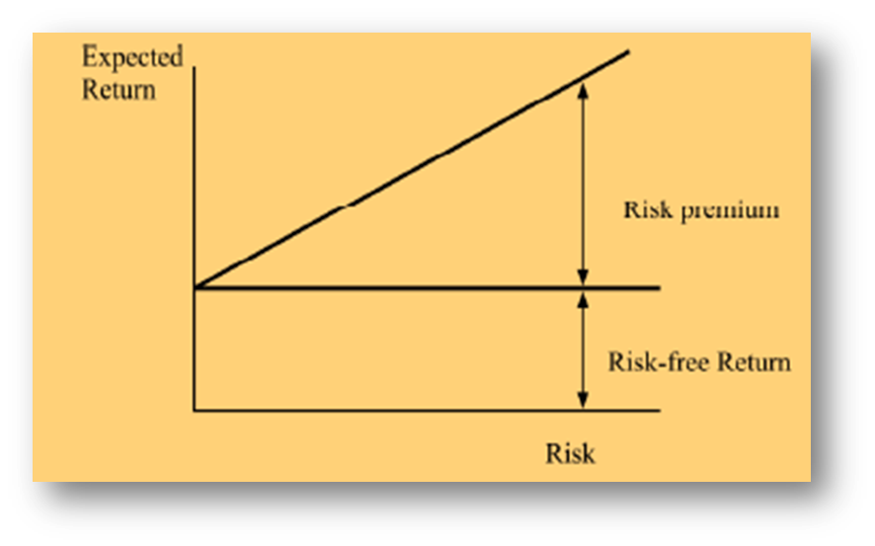
Risk Return Trade-off
Risk and expected return move in tandem; the greater the risk, the greater the expected return.

Slide 20
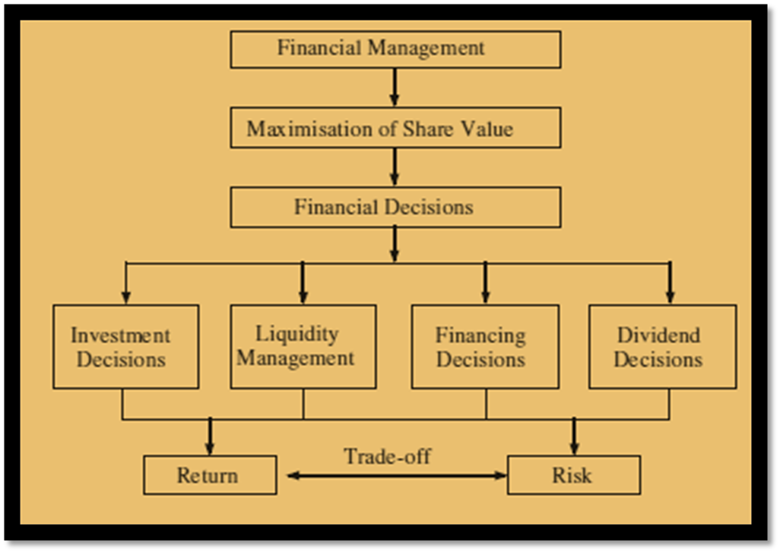
Overview of Financial Management

Slide 21
Agency Problems: Managers Versus Shareholders’ Goals
There is a Principal Agent relationship between managers and shareholders.
In theory, Managers should act in the best interests of shareholders.
In practice, managers may maximise their own wealth (in the form of high salaries and perks) at the cost of shareholders.

Slide 22
Agency Problems: Managers Versus Shareholders’ Goals
Managers may perceive their role as reconciling conflicting objectives of stakeholders. This stakeholders’ view of managers’ role may compromise with the objective of SWM.
Managers may avoid taking high investment and financing risks that may otherwise be needed to maximize shareholders’ wealth. Such “satisfying” behaviour of managers will frustrate the objective of SWM as a normative guide.
This conflict is known as Agency problem and it results into Agency costs.

Slide 23

Agency Costs
Agency costs include the less than optimum share value for shareholders and costs incurred by them to monitor the actions of managers and control their behaviour.

Slide 24
Financial Goals and Firm’s Mission and Objectives
Firms’ primary objective is maximizing the welfare of owners, but, in operational terms, they focus on the satisfaction of its customers through the production of goods and services needed by them.
Firms state their vision, mission and values in broad terms.
Wealth maximization is more appropriately a decision criterion, rather than an objective or a goal.
Goals or objectives are missions or basic purposes of a firm’s existence.

Slide 25
Financial Goals and Firm’s Mission and Objectives
The shareholders’ wealth maximization is the second-level criterion ensuring that the decision meets the minimum standard of the economic performance.
In the final decision-making, the judgement of management plays the crucial role.
The wealth maximization criterion would simply indicate whether an action is economically viable or not.

Slide 26
Organisation of the Finance Functions
Reason for placing the finance functions in the hands of top management
  Financial decisions are crucial for the survival of the firm.
  The financial actions determine solvency of the firm
  Centralisation of the finance functions can result in a number of economies to the firm.

Slide 27
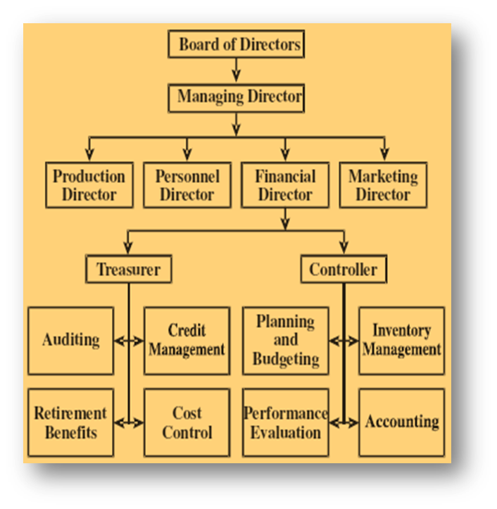
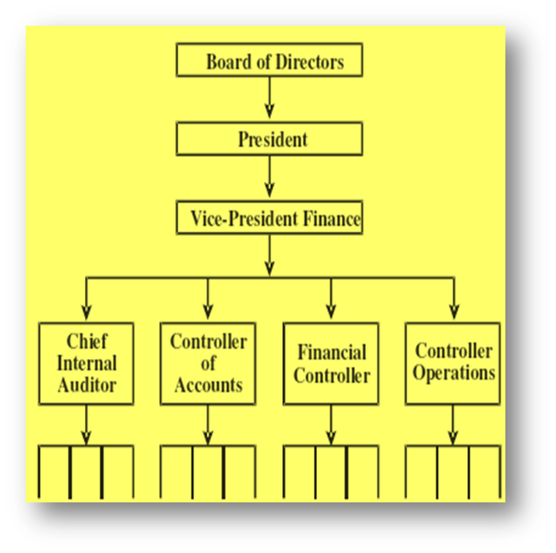
Organisation of Finance Function
Organization for finance function in a multidivisional company
Organization for finance function

Slide 28
Status and Duties of Finance Executives
The exact organisation structure for financial management will differ across firms.
The financial officer may be known as the financial manager in some organisations, while in others as the vice-president of finance or the director of finance or the financial controller.

Slide 29
Role of Treasurer and Controller
Two officers—the treasurer and the controller—may be appointed under the direct supervision of CFO to assist him or her.
The treasurer’s function is to raise and manage company funds while the controller oversees whether funds are correctly applied.

